Slide 1
The e-business effect
By
Christopher Brossman
2/26/2016

Slide 2
Contents
Project Background
Overview of Methodology
Findings
Recommendations to Ferguson
Questions

Slide 3
Project Background

Slide 4
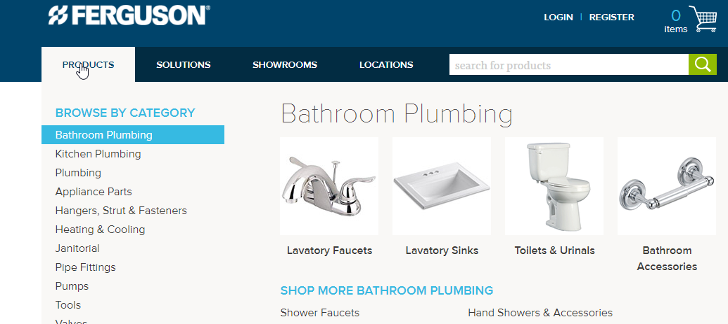
What is Ferguson?
Plumbing, HVAC, Waterworks, and Industrial wholesaler.
Most of revenue comes from large (B2B) customers, contracting large jobs
Ferguson also has a B2C side where they focus on selling kitchen and bath items directly to consumers.
Ferguson is the largest firm in its market – but many firms

Slide 5
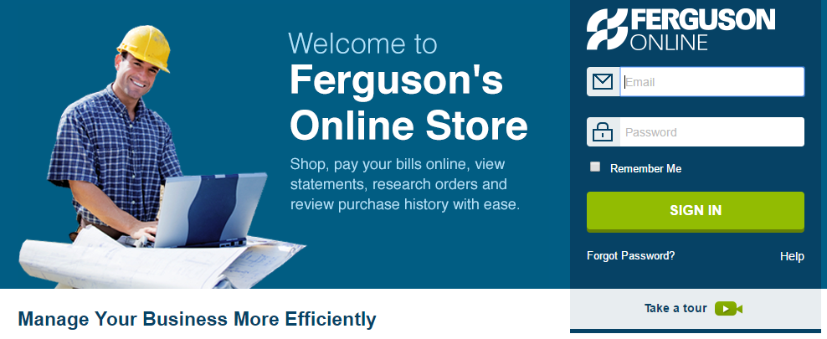
What is FOl?
Ferguson Online (FOL) is Ferguson’s Online Store.
Similar to a bank’s online store
Primary purpose is to reduce labor needs of branch
A customer can make orders, check bills and perform a number of self-service events
The online store is used mostly by top Ferguson customers, but can be used by any customer
Sales is incentivized to target largest customers for onboarding
Some customers are system to system – which is counted as FOL

Slide 6
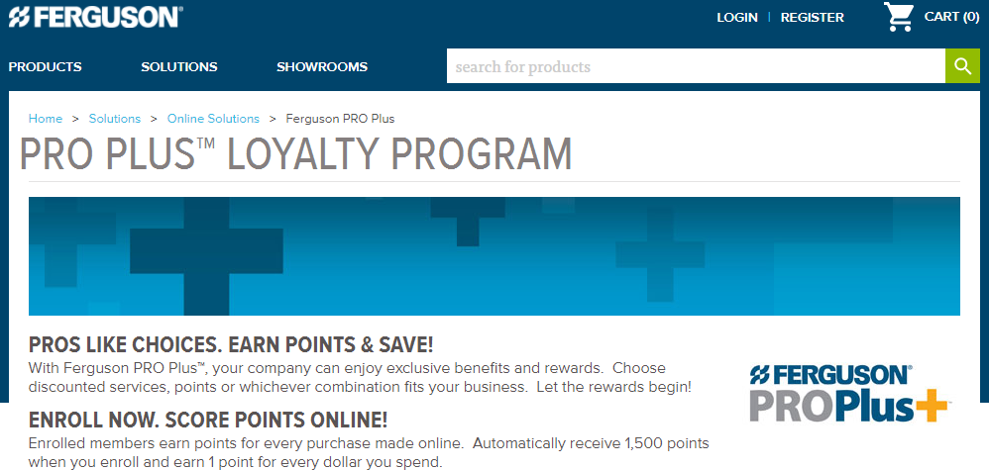
What is pro plus?
Loyalty Program to incentivize sales on FOL
All customers are entered into Bronze when joining FOL
FOL customers can opt into Silver by accepting terms
Generate points from sales, which can be used to buy reward products.
Points required for some purchases can only be leveraged by larger customers

Slide 7

about the customer
The typical contactor has relationships with many suppliers.
Several physical locations aid in picking something up close to the job
Can leverage for best price
Make sure item is in stock
Business is heavily relationship based
Like to “spread-out” sales
Contractors come in many sizes
Repair and Remodel plumbers are numerous and typically small businesses (a few employees)
HVAC & Mechanical contractors are typically larger and have many employees and entire departments

Slide 8
The question
When a Ferguson customer uses the eBusiness solution do their sales increase? If so, by how much?
Why this may be true
If customers likes FOL they may use for all orders instead of “spreading” out business
The solution is unique to Ferguson and maybe a few other larger wholesalers.
Why this may not be true
Customers don’t want do their “own” ordering
Customers cant find what they need
Customers like the relationship with salesperson
Customers suspect worse pricing.

Slide 9
Methodology

Slide 10
Methodology Overview
Create Synthetic Control to FOL customers
Fixed Effects Regression Model
Interpret Coefficient of Interest
1:1 propensity score matching method
Control for time invariant effects and certain time variant effects
Used to reduce bias
All data used was obtained from internal databases. All data was transformed from dimensional and transactional data tables. All transformations & statistics were preformed using SQL & R.

Slide 11
What is matching
What is matching?
Matching is a technique to match the treated group with those not treated in the population but who are similar to emulate a suitable control
Why is it important?
Matching reduces bias, when the treated group differs greatly from the overall population, or if the treatment is non-random.
How was matching done?
1:1 propensity score matching
How is it used
Just for pre-processing for regression analysis

Slide 12



The need for matching
FEI Customer Population
FOL Customer Population
Not Comparable
Samples are not comparable because treatment is non random causing samples to be very different – eBusiness sought after most desirable FEI customers for FOL

Slide 13
The need for matching
FEI Customer Population after matching
FOL Customer Population
Comparable
Matched samples will greatly reduce bias. We still need to control for differences within each population. Regression will help.

Slide 14
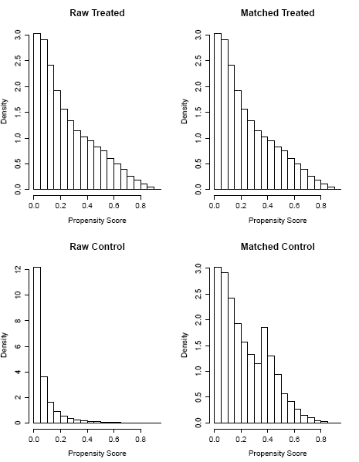
Matching evaluation
Treatment and control groups are not similar prior to matching
Treatment and control groups are much more similar after matching

Slide 15
Still need to control for other variables…
Anything else that can explain sales changes will contaminate the “eBusiness” effect
We need to control for this to isolate “eBusiness” effect
Things held constant in analysis using Fixed Effects / DiD Regression
Fixed Effects (things that don’t change over time)
Such as type of customer
Macro Economic Effects
(economic changes in US)
Micro Economic Effects at Branch level
(economic changes in MSA)
Tenure
Individual time – loosens assumption of design

Slide 16
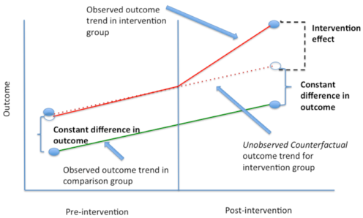
Difference in difference intuition

Slide 17
Identification strategy did regression model
$$\log\left({Sales}_{itb}\right)= α_{i}+ {β EBC}_{it}+ {γ TEN}_{IT}+ {θ log⁡(ACNT Sales}_{tb})+ δ_{t}+ ε_{itb}$$
Variables: i indexes customer, t indexes time (year-month), b indexes the branch of the customer
Sales is the sales of customer
EBC is a dummy variable = 1 if customer is an e-Business customer at that point in time and 0 otherwise. This is the variable of interest.
TEN is the count of months with any Ferguson purchase
ACNT is the branch of the customer

Slide 18
Identification strategy did regression model
$$\log\left({Sales}_{itb}\right)= α_{i}+ {β EBC}_{it}+ {γ TEN}_{IT}+ {θ log⁡(ACNT Sales}_{tb})+ δ_{t}+ ε_{itb}$$
Parameters
𝜶 holds constant time invariant effects such as customer type
𝛽 is the variable of interest (the e-business effect on sales)
𝛾 This allows for different pre-existing trends and holds constant the effect of spending more due to having higher tenure.
θ holds constant branch level effects such as local market forces.
𝜹 holds constant effects over time constant to all customers – macro economic effects
𝜀 Is the error left unexplained by the model

Slide 19
Identification strategy did regression model
$$\log\left({Sales}_{itb}\right)= α_{i}+ {β EBC}_{it}+ {γ TEN}_{IT}+ {θ log⁡(ACNT Sales}_{tb})+ δ_{t}+ ε_{itb}$$
Standard Errors
To correct for serial correlation, the standard errors were clustered at the branch level.
Done to not overstate significance

Slide 20
Findings of Analysis (all findings were statistically significant unless otherwise noted)

Slide 21
Overall findings
FEI customers increase their sales by 21.57% after becoming an FOL customer all else equal
FEI customers increase their sales by 12.59% after becoming a S2S customer all else equal
FEI customers increase their sales by 21.51% after becoming an eBusiness customer (either S2S or FOL) all else equal

Slide 22
Overall findings
Since average historical sales per month of the FOL group is roughly $17,252, we realize incremental sales of $3,721 per customer per month
Since average historical sales per month of the S2S group is roughly $51,793, we realize incremental sales of $6,521 per customer per month

Slide 23
EBUSINESS EFFECT BY BUSINESS GROUP

Slide 24
EBUSINESS EFFECT - TREND
Overall AVG
Effect is statistically insignificant after 24 months

Slide 25
Ebusiness Effect on gross profit & Margin
Gross profit gross nearly as quickly as sales indicating nearly identical profit margins

Slide 26
Ebusiness effect by pro plus engagement
Silver customers grow incremental sales faster and have higher engagement levels than Bronze customers
Not significantly different from zero

Slide 27
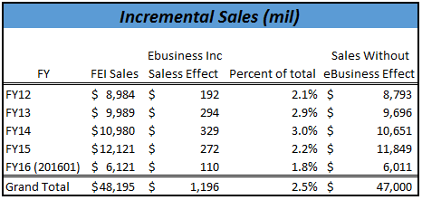
INCREMENTAL SALES
The “eBusiness effect” increased total FEI sales by 2-3% each year.
The far right column highlights what sales are estimated to be if no customer had ever been an ebusiness customer.

Slide 28
Inc. sales over time

Slide 29
Recommendations

Slide 30
how to get fei to $25B
Invest in eBusiness Customer Onboarding
Overall effect is 21.51% higher sales
The eBusiness solution has caused a lift in incremental sales by 2-3% of total sales each year since FY12
Increase the Onboarding Process & Reduce Churn
Churn is a drag on sales and the eBusiness effect. As churn reduces the eBusiness effect grows.
Promote the Pro-Plus Loyalty Program
Customers who engage in Proplus grow incremental sales faster than their Bronze counterparts
Proplus customers churn less frequently from eBusiness.
Invest more to understand customer churn & customer onboarding.
Use existing tools to reduce churn: Customer Action Report/Pipeline MGMT/CRM
Gross profit is growing nearly as fast as sales, indicating we are growing profitability as well as top line sales.

Slide 31
Questions

Slide 32
Analysis reproducibility
All data and analysis documents to recreate the analysis can be found here
S:\eCommerce\E-Commerce\Analysis & Reporting\Omni-Channel\eBiz effect on FEI sls
Programs used:
Oracle SQL
R

